Slide 1
Identification of 3D attention points in
Virtual Reality scenes
By
Sandeep Tandra
Vineel Gannu
April 06, 2020

Slide 2
Presentation Outline
1. Project Introduction
2. Background Discussion
a. Why this project?
b. ABM and CBT
3. Dataset Creation
4. Model Creation
5. Model Evaluation
6. Conclusion and Future work
7. References and Links

Slide 3
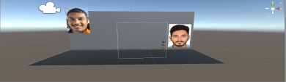




First things First!!
What are we doing in this project?
3D scene
Dataset
Model
Trained Model
Attention points
Unseen 3D scene
Users/participants
Predicting 3D attention points in unseen scenes

Slide 4
Background Discussion
Why this project??
Application areas
Our main focus is on health care (ABM and CBT) and Business (Marketing)
Healthcare​
Education
Business​
Military
​

Slide 5
ABM and CBT
ABM (Attention Bias Modification)
A treatment for anxiety disorders
Designed to shift attention away from threat
CBT (Cognitive Behavioral Therapy)
Cognitive Therapy
Focuses on identifying emotional responses, thinking patterns
Behavioral Therapy
Addresses behaviors and thinking patterns and incorporates strategies such as mindfulness and emotional regulation

Slide 6
Dataset Creation
Creation of virtual reality environment
Unity software
2 images with different emotions
https://drive.google.com/open?id=1mRtVv3y0xmt7XdQ-eGYdc8--AU87t1sd
Recording the data from the participants
Six participants
Tobii eye tracker
Features such as object position, object scale, gaze positions are recorded
Structuring the data
Excel format
1000 instances are captured

Slide 7
3D scenes have x, y, z coordinates, each position value is split into 3 different features.
In total we have 33 features in which 3 are target labels.
E.g. Object1position (x, y, z) -> object1position_x, object1position_y, object1position_z
Fig 1. Few samples from the dataset

Slide 8
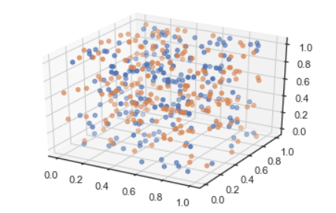
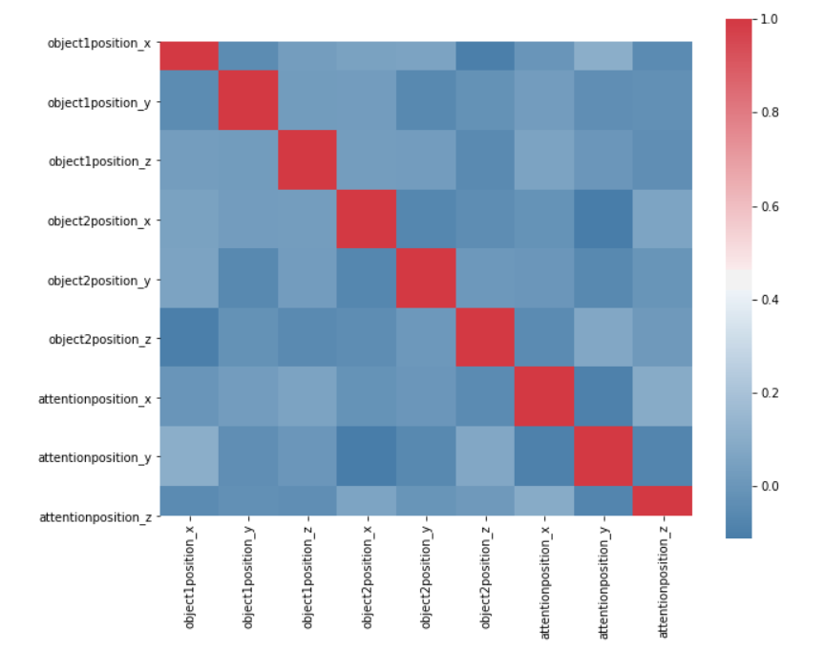
Visualizing data
Object2 position
Object1 position
Fig.2 Normalized data of object 1 & 2 positions
Fig.3 Correlation matrix

Slide 9
Model
So far we have seen the data shape, correlation between the features and the multi target labels.
Now which model to use for the above features
From our research, for multi target labels we can use
Multi target regression(MTR) using Clustering and Decision trees.
-Using trees for clustering, aka Predictive Clustering Trees (PCT)
Neural Networks
- Multi layer perceptron
9/15

Slide 10
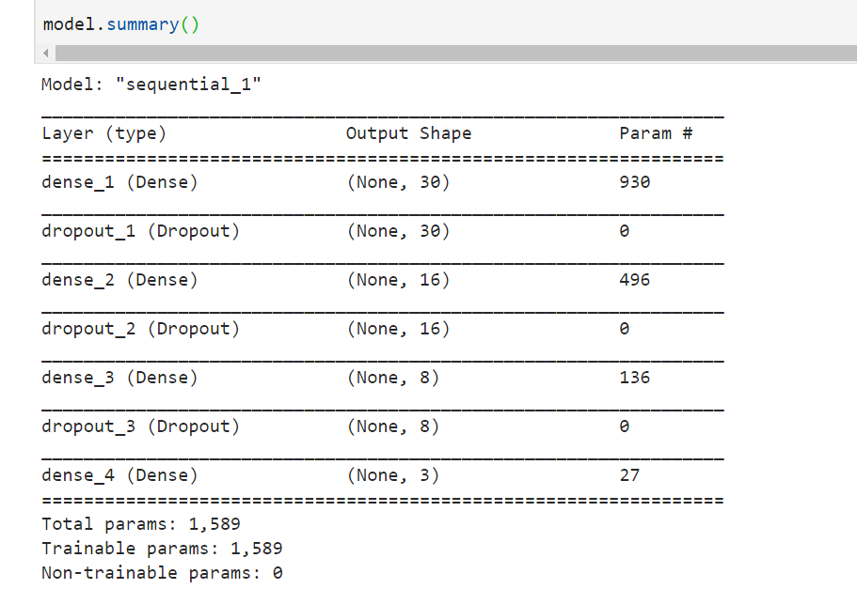
Model ,cont
Multi Layer Perceptron Model
Input
Output

Slide 11
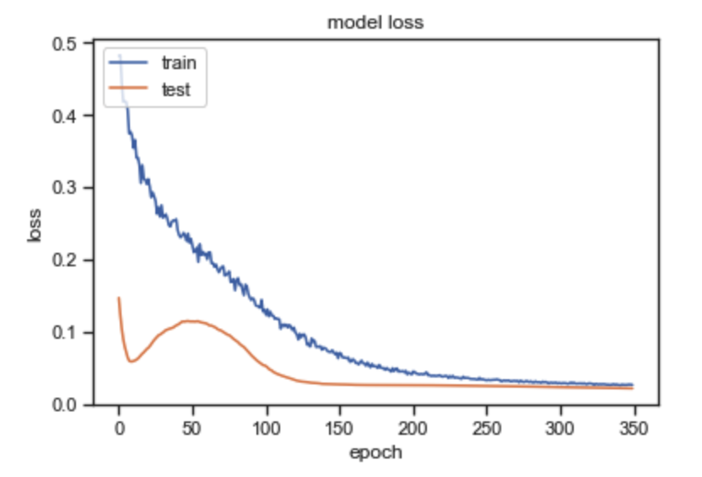
Model testing
Activation Function : Tanh
Optimization Algorithm : Adam
Metric : mean square error
Training samples : 560
Validation samples : 240
Test samples : 200
RESULT
At the end of 400 epochs:
Training error=0.0262
validation error=0.0202
Predicted value = [ -3 ,3.4 , -7.0]
Actual value = [-3, 2.3 , -7.9]

Slide 12



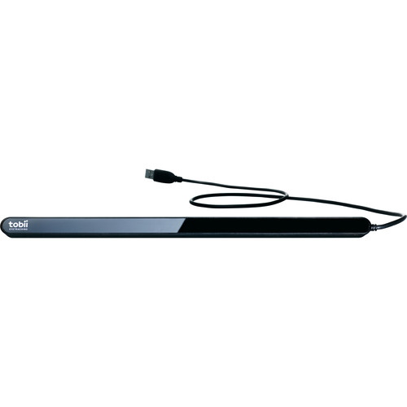
Resources Required
Libraries Used
Keras
Sklearn
Numpy
Pandas
Matplotlib
Seaborn
mpl_toolkits
12/15

Slide 13
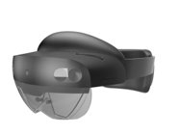
Conclusion and Future work
This simulation is to test whether 3D attention points can be predicted or not.
But at the end we almost predicted the attention points with very small loss.
As of now Microsoft Holo lens 2 are not available in the market to experiment this project in the full-fledged 3D scene where user can walk through the virtual environment to produce the heatmap data of attention points.
So, once we lens will be available in the market, we plan to experiment this again with high accuracy

Slide 14
Thank you so much !!
Stay home and stay safe

Slide 15
References and Links
[1] Mogg K, Waters AM, Bradley BP. Attention Bias Modification (ABM): Review of Effects of Multisession ABM Training on Anxiety and Threat-Related Attention in High-Anxious Individuals. Clin Psychol Sci. 2017;5(4):698–717. doi:10.1177/2167702617696359
[2] Rector, N. (2010). Cognitive- behavioural therapy. An information guide. In Centre for Addiction and Mental Health. http://knowledgex.camh.net/amhspecialists/resources_families/Documents/cbt_guide_en.pdf
[3]Cognitive behavioural therapy (CBT). Royal College of Psychiatrists. https://www.rcpsych.ac.uk/mental-health/treatments-and-wellbeing/cognitive-behavioural-therapy-(cbt). Accessed Feb. 7, 2019.

